Slide 1

Digital Analytics & Beyond
Aug 2016
The information contained in the document is proprietary to Tata Industries Limited- Tata Insights & Quants Division and is strictly confidential. In consideration of receipt of this document, the recipient agrees that the information is being shared only for the limited purpose. The recipient of this information further agrees to maintain such information in confidence and to not reproduce, disclose, duplicate, electronically transmit or use in whole or in part for any other purpose. Prior written consent shall be obtained from the Insights & Quants Division of Tata Industries in case the information is necessitated to be shared with anyone other than the Recipient to whom this information is addressed. The above restriction shall not limit the right to use the information contained in this deck, if it is obtained from another source without restriction. © Copyright, Tata Insights & Quants Division, Tata Industries Limited

Slide 2





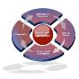

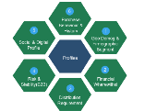
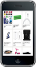



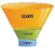



About Tata iQ
Analytic Services
Largest and Richest Database
Collaboration and One Tata
Proprietary
Pricing
Store
Assortment
Offline
Data
ShopsAPP
Public
TSSS’15
Affiliate
Marketing
Prospecting
Online
Data
Digital
Internal
Group-wide Loyalty
Advanced Analytic Solutions
Data Enrichment
Building One Tata
Profiling, Segmentation
Predictive Analytics
Machine Learning
Quantitative Analytics
Unified customer view
Maximize Revenue
Minimize Expenses
Encompassing Loyalty
900MM People Base
300 MM Enriched Base
Data across Individuals & Institutions
Confidential Property of Tata Industries Ltd – Tata Insights & Quants Division

Slide 3
Learning Objectives
Through Digital Analytics
What’s the process I will have to take to meet my outcomes
What is the data I will need to help me through this process
What outcomes can I hope for? What problems can I solve?
Across the digital landscape of web, app, social and email
Across the digital landscape of web, app, social and email
Where are some Companies today?
Can we get there?
Confidential Property of Tata Industries Ltd – Tata Insights & Quants Division

Slide 4

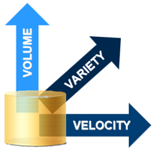
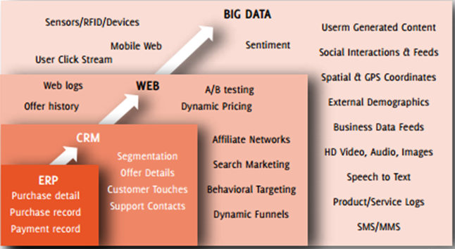
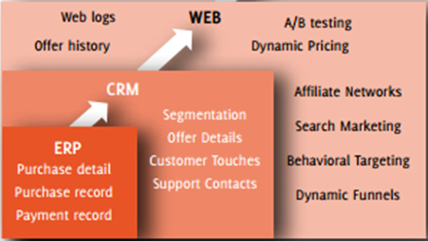
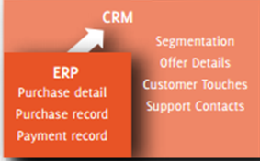
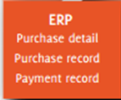
Big Data Characteristics
+ Interactions
Big Data = Transactions
+ Intent
Confidential Property of Tata Industries Ltd – Tata Insights & Quants Division

Slide 5
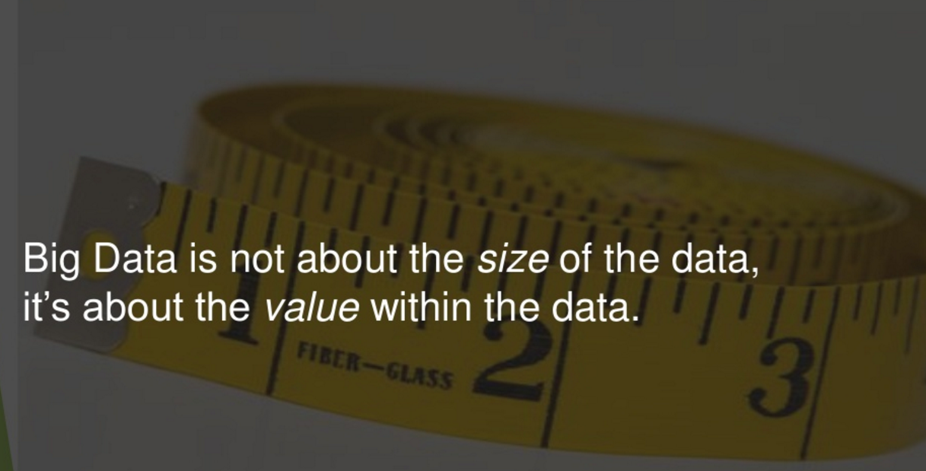
Confidential Property of Tata Industries Ltd – Tata Insights & Quants Division

Slide 6

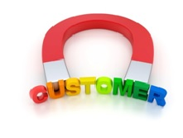



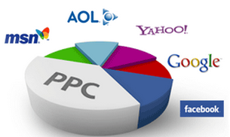

Digital Analytics Landscape
Objective
Increase in Brand Awareness
Retain Existing Customers
Lead/Prospect Generation
Sale/Profit Improvement
Analytics
Customer Segmentation
Attribution Modeling
Text Mining
Forecasting
Lead/Prospect Scoring
Lookalike Modeling
Event Triggers
CTR Models
Pathing
Design of Experiments
Pricing
Channels
Website/Email/Mobile
Social Media/Video/Webcast
Search/Paid AdWords
Confidential Property of Tata Industries Ltd – Tata Insights & Quants Division

Slide 7

Digital Analytics Landscape
05
Web Analytics
Performance of your website
Behaviour of visitors
to your website
04
Mobile App Analytics
Performance of your mobile app
Behaviour of app users and
Interaction with the brand
04
03
Social Media Analytics
Interactions on social media platforms
Understand key influencers,
sentiment and trends
02
Campaign Analytics
Offers, Target population, List creation, execution, response rate & channel optimization
03
Confidential Property of Tata Industries Ltd – Tata Insights & Quants Division

Slide 8



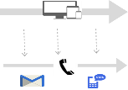
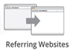
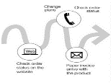




Step 1 – Think Outcomes, Define Success
Awareness
Consistent offer & message
No. of Followers,
Impressions, Web traffic etc.
Awareness
1
Social Media
Engagement
Engagement
Promote & Service
2
Web Logs
# of Retweets, time on page, time on app
Conversion
Conversion
Personalize & Convert
3
Clicks, Leads,
Revenue, Conversion Rates
4
Service
Multi-device Data
Service
Offer on digital channels
Sign-ups, NPS,
R-F-M
5
Loyalty
Loyalty
Increase satisfaction & value
Customer Transaction
Confidential Property of Tata Industries Ltd – Tata Insights & Quants Division

Slide 9











Step 2 – Gather Digital Data
Search Location Behaviour Sentiment Network
3.5 B
Searches on Google per day
2x
increase in "near me" search interest in 2015
100 M
hours of “how-to” content watched on YouTube in 2015
82%
of smartphone users consult their phones while in a store
30%
of Global population is active on Social Media
In a world where digital data is exponentially exploding, an exploratory mindset will help gather data – which is of use today, but also which could be of use tomorrow
Confidential Property of Tata Industries Ltd – Tata Insights & Quants Division

Slide 10
Step 3 – Analyze, Act & Measure
Analytics
Action
Measurement
No. of Followers,
Impressions etc.
Retweets, time on page, time on app
Clicks, Leads,
Revenue
Sign-ups, NPS,
R-F-M
Experiment !
Remember the Success Measures in Step 1?
Confidential Property of Tata Industries Ltd – Tata Insights & Quants Division

Slide 11






Analytics Solution
Basic Measurement
Custom Measurement
Integrated Measurement
Customer Intelligence
Digital Maturity Lifecycle
Return on Investment ( ROI )
+
Basic Web Analytics Reports
Custom Report & Metric
Digital
Offline
Predictive Analytics
Customer Profile
Digital data to be fed into other applications to power marketing and business operations
Digital data is integrated with offline marketing & backend data to study its impact
Customer identification across different channels to build their holistic view & cross-channel interactions
Reports gets aligned to Business strategy & industry vertical
Digital Analytics Maturity
Setting analytics tag on website and few simple reports
Confidential Property of Tata Industries Ltd – Tata Insights & Quants Division

Slide 12
05
Powering Your
Website Presence
Confidential Property of Tata Industries Ltd – Tata Insights & Quants Division

Slide 13




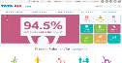





The Web Analytics Journey
01:
WHAT OUTCOMES
DO YOU WANT TO ACHIEVE?
02:
WHAT DATA DO I HAVE,
TO CREATE INSIGHTS?
03:
ANALYZE, ACT, MEASURE
1. Sources of Visits
1. Measure & Monitor Visits and Engagement Parameters
1. Digital Showroom -
Showcase your Brand
2. Customer journey on website
2. Give the Visitor a Brand Experience
2. Optimize the site to
Enhance Experience and Drive Conversions
3. Differences in behaviour by device
3. Service your customers
4. Drive Leads and Conversions
Through a three pronged strategy
Confidential Property of Tata Industries Ltd – Tata Insights & Quants Division

Slide 14



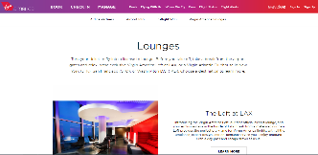
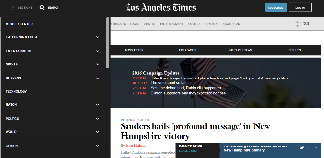
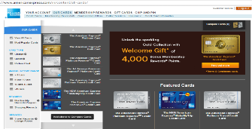
1. Web Outcomes – What are the drivers?
Think “Showroom”
Think “Experience”
Think “Relevance”
Loyalty Program Sign In
A Digital presence allows you to show each customer what you think he / she would like to see
Easy Search Access
Prompting Action – “Subscribe”
Basics –
Book, Check-In, Manage
Brand Promise Reflected:
“STYLISH”
Easy Navigation
Focus on Social & Live Updates
Gold Card Highlighted for User A
Another one would be for User B
Confidential Property of Tata Industries Ltd – Tata Insights & Quants Division

Slide 15




2. Web Data: Metrics Definitions 101
Can we skip this?
Visitor – An individual who arrives at your website and proceeds to browse
Visit – A session of time spent by user on a website . A visit is terminated when user leaves the website or shows an inactivity of 30 min.
Avg. Visit Duration – Average time spent by a user during his visit to website
Bounce rate – % of user visits with only 1 page/ visit i.e. the user entered the website and left without viewing any other page on that website
Source of Visits: Visits on a website can originate from a variety of sources which can be attributed to either Paid or Organic (free results based on popularity & relevance)
Confidential Property of Tata Industries Ltd – Tata Insights & Quants Division

Slide 16
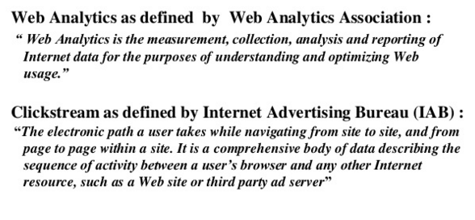
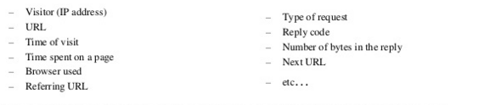
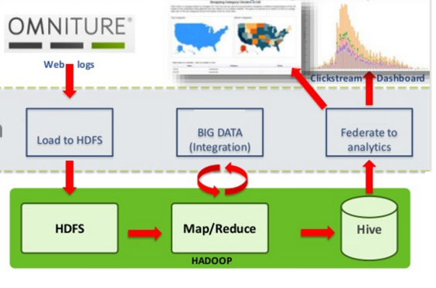
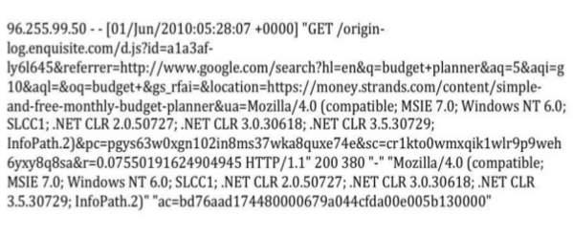
2. Web Data: Clickstream Data
Confidential Property of Tata Industries Ltd – Tata Insights & Quants Division

Slide 17
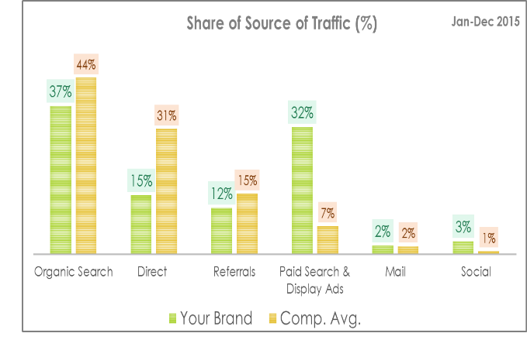
2.a. What Data & Insights do we need?
Say, to drive traffic
Analyze Traffic Source
Identify Opportunities for Optimizing Each Source
Share of Visits Driven by Top Referral Site
Jan-Dec 2015
Visits driven to:
Constitutes ~ 17.5 Million visits to these websites in this time period
Confidential Property of Tata Industries Ltd – Tata Insights & Quants Division

Slide 18
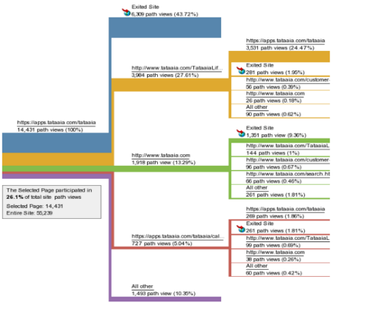
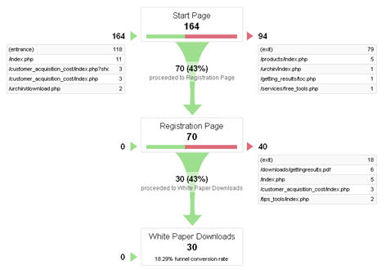
2.b. What Data & Insights do we need?
Say, to increase conversions
Customer Journey
Micro Conversions
Popular customer paths and sources
Pages responsible for exit and poor engagement
Track micro conversions in sales cycle by setting different goals in customer journey
Evaluate effectiveness of campaign landing pages
Confidential Property of Tata Industries Ltd – Tata Insights & Quants Division

Slide 19
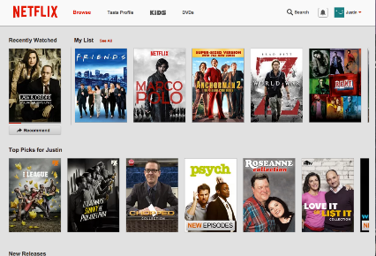
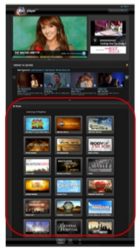
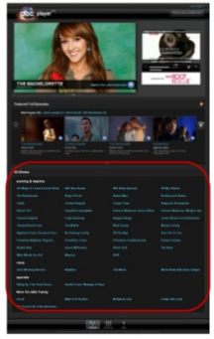
3. Analyze, Act, Measure
Web Optimization
Web Personalization
Layout 1
Layout 2
Data Captured:
Types of content that you’ve consumed
How you’ve rated different shows
Action Taken:
Recommend what you might like
Personalization & Relevance drives conversions
Measure desired Actions (“Direct Video Click” Vs. “Exit”) in both Layout 1 & 2
“25% exited in Layout 1 Vs. only 5% in Layout 2”
Let the results decide which Layout is better
Confidential Property of Tata Industries Ltd – Tata Insights & Quants Division

Slide 20
A Quick Recap
Raison d’etre
Data
Analyze, Act & Measure
Specific: Business Problem Visitors spend more time on my website, browse 7 pages, but drop off just before booking a hotel |  | What data will I need? Visitor segments Visitor journey Drop-off point Time spent just before drop-off Etc… |  | What Insights can I generate? It takes 3 mins. to fill up the personal & preference details before booking Most exit after 1 min. |  | What Action Can I take? Ask for mandatory details only Allow for conversion first Then ask for preferences or upgrade opportunities
Exploratory : Business Imperative I’d like to increase traffic to my website |  | What data will I need? Share of source of web traffic Keyword search performance Top Referral websites to my competition Etc.. |  | What Insights can I generate? Competitors get 10% of their traffic from an aggregator site, while I get only 2% Sentiment on that website for my brand is negative |  | What Action Can I take? Respond proactively on the aggregator website Engage with visitors to the aggregator website Improve sentiment by addressing negative comments
Continuously measure the parameters to verify if Actions are yielding desired business outcomes
Confidential Property of Tata Industries Ltd – Tata Insights & Quants Division

Slide 21






Minor Detour 1 : Post Login Experience
Visitor
Benefits for Customer Service Post Login
Web beacons or cookies tell you a little about your visitors’
Online behaviour
Deeper Customer Engagement
Logs in
But the moment he / she logs in, you know the person better
Faster Customer Servicing with Customer data already handy
Opportunity to Personalize
Reduced Cost of Servicing Customer Online
Create a fruitful post login experience
Confidential Property of Tata Industries Ltd – Tata Insights & Quants Division

Slide 22




Minor Detour 2 : Website on Mobile
A low share of mobile visits to your website might mean :
Lookout for:
Do users prefer desktop for competition sites as well?
Your users prefer desktop over mobile to access a site
Visitors can access your Website through
Desktop OR Mobile
A mobile optimized site:
leverage browser caching, and reduce redirects
Your site may not be optimized for mobile,
Providing your visitors a poor experience
Is your website responsive to different screen sizes?
Confidential Property of Tata Industries Ltd – Tata Insights & Quants Division

Slide 23
04
Extracting Value from Your
Mobile App
Confidential Property of Tata Industries Ltd – Tata Insights & Quants Division

Slide 24
The Mobile App Analytics Journey
01:
WHAT OUTCOMES
DO YOU WANT TO ACHIEVE?
02:
WHAT DATA DO I HAVE,
TO CREATE INSIGHTS?
03:
ANALYZE, ACT, MEASURE
1. Digital Showroom -
Showcase your Brand
1. Measure & Monitor Visits and Engagement Parameters
Downloads |  | Time on App
Users |  | Acquisitions by Channel
Session Length |  | Screen Flow
Session Interval |  | Retention
2. Give the Visitor a Brand Experience
2. Optimize the app to
Enhance Experience and Drive Conversions
3. Service your customers
4. Drive Leads and Conversions
Confidential Property of Tata Industries Ltd – Tata Insights & Quants Division

Slide 25










Mobile App Analytics Landscape
2
User Action Analysis
1
User Flow Analysis
Where does the user click?
What actions does he take on my app?
What is the User journey across my app?
User Retention Analysis
3
Can I actively engage my users?
Can I be more relevant for my users?
How many users come back to my app after install?
Triggers for coming back?
4
Targeted messaging
Confidential Property of Tata Industries Ltd – Tata Insights & Quants Division

Slide 26
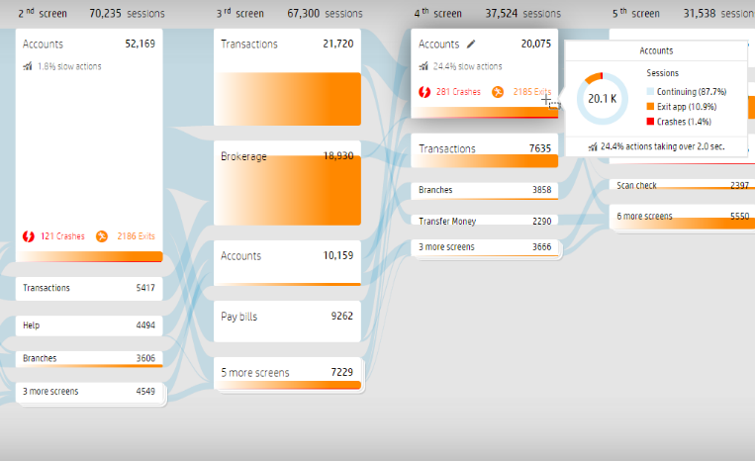
User Flow Analysis
1
Outcome : Better User Experience on App / Higher Engagement on App
Data – Screen Flow
Response times at each stage
% exits from each stage
Analyze, Act, Measure
24% users face a high response time on the “Accounts” screen
10% Users exit at this stage
Reduce information displayed
Reducing load time
Measure response times and % exits (hopefully both reduced)
Confidential Property of Tata Industries Ltd – Tata Insights & Quants Division

Slide 27
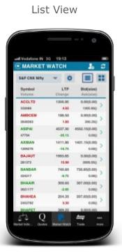
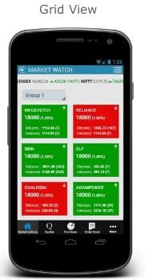
User Action Analysis
Outcome : Higher Engagement, defined as higher number of views of Content
2
Data – Screen Flow, Session Length
User clicks or Actions on Search Results
Available by different layout options
Analyze
List View
10% of users click on any item below the Top 3
75% exit on the next screen
Grid View
65% of users click on an item below the Top 3
Only 10% exit on the next screen
Action
Change default option to Grid View
Confidential Property of Tata Industries Ltd – Tata Insights & Quants Division

Slide 28
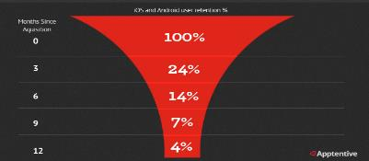
User Retention Analysis
3
Outcome : We are engaging so heavily with the user, sending continuous notifications. Yet only 4% of users who have downloaded our App use it after 12 months
Retention Rates with five push notifications a day
Data - Retention
Percentage of users who use the app n months after download
Analyze, Act (Experiment), Measure
To users to whom you send five push notifications a day
Only 4% continue to use the app after 12 months
To users to whom you send one push notification a day
25% continue to use the app after 12 months
Retention Rates with one push notifications a day
100%
56%
Action
Reduce number of Push Notifications
35%
30%
25%
Confidential Property of Tata Industries Ltd – Tata Insights & Quants Division

Slide 29
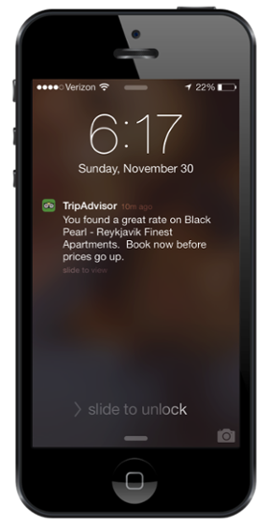
Targeted Messaging
4
Outcome : Incentivize or nudge conversions
Five Golden Rules for Notifications
Data
User was browsing for Hotel rates in Reykjavik
Relevance
Simplicity
Choice
Timing
Location
1
2
3
4
5
Analyze, Act
Auto tracking of rates
Send a notification as soon as Rates drop – or an offer pops up
Confidential Property of Tata Industries Ltd – Tata Insights & Quants Division

Slide 30
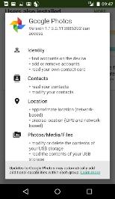
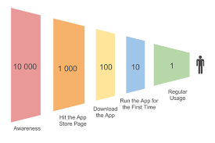

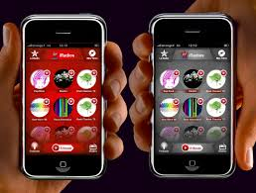
A Quick Recap
Raison d’etre
Data
Analyze, Act & Measure
Business Imperative Increase conversions on App |  | What data will I need? Mobile data User data App usage data |  | What Insights can I generate? User behaviour User needs Etc... |  | What Action Can I take? Optimize app design Change layout or flow
Continuously measure the parameters to verify if Actions are yielding desired business outcomes
Confidential Property of Tata Industries Ltd – Tata Insights & Quants Division

Slide 31

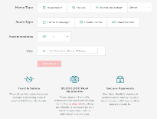
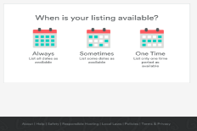
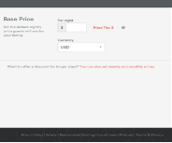
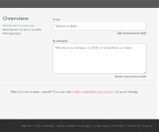
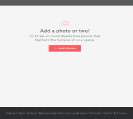
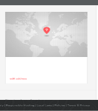
Case Study: Increasing Conversion Rates
Airbnb continuously monitored the drop-offs of first time hosts to streamline the Listing process
Collect Relevant App Data
Generate Insights on User Behaviour
Act to drive outcomes
Where do Users drop-off in Listing Process?
Most users drop off when asked to enter Listing details upfront
Split Listing details across three screens
Outcome – User friendly Listing Process. Conversions went up 400%
Confidential Property of Tata Industries Ltd – Tata Insights & Quants Division
Notes:
http://www.computerweekly.com/news/2240203420/Case-study-How-Premier-Inn-uses-mobile-analytics
https://www.marketingweek.com/2013/05/28/premier-inn-to-harness-big-data-insights-to-bolster-android-audience/
https://mixpanel.com/case-study/airbnb/

Slide 32
03
Making your presence felt on
Social Media
Confidential Property of Tata Industries Ltd – Tata Insights & Quants Division

Slide 33
Social Media Landscape
01:
WHAT OUTCOMES
DO YOU WANT TO ACHIEVE?
02:
WHAT DATA DO I HAVE,
TO CREATE INSIGHTS?
03:
ANALYZE, ACT, MEASURE
Social Media Channles
Awareness (Reach)
Engagement
Drive traffic to website
Leads & Conversions
Data on Posts | Data on Followers | Data on Channels
Likes , Comments , Shares | Geography | Fan count , No. of Post
Retweet , Favourite, Shares | Geography , Interest , Follower Count | Followers count , Similar brands
Comment , Like , Dislike | Geography | No. of Video Upload, related Channel
Like, Comment | Geography , Designation | Follower count
Analysis & Measurement
Industry Benchmarking Online Reputation Management Topic Mining Sentiment Analysis Lead Generation Influencer detection
Confidential Property of Tata Industries Ltd – Tata Insights & Quants Division

Slide 34
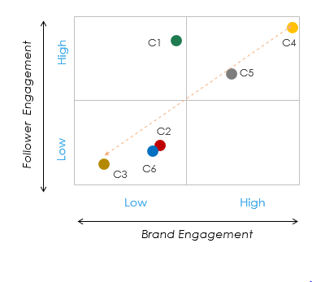
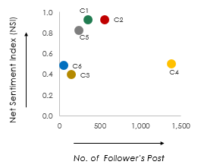


Social Media Analytics Examples
Social Engagement
Social Sentiment
Voice of Customer
Positive Comments
Negative Comments
Brand engagement represents number of times brand made an effort to communicate with follower’s across social media (FB, Twitter, YouTube, LinkedIn)
Follower engagement represents number of response from followers to brand’s post across social media, it is calculated by aggregating standardized value of certain parameters
Sentiment Index [0-1] displays net sentiment of brand on ‘mentions’ by its follower base. It is calculated as :( Positive post + Neutral Post – Negative post ) / (Positive post + Neutral Post + Negative post )
Confidential Property of Tata Industries Ltd – Tata Insights & Quants Division

Slide 35




A Quick Recap
Raison d’etre
Data
Analyze, Act & Measure
Business Problem Not able to engage traffic on social media pages of brand Brand has lots of negative comment mentioned in social media |  | What data will I need? Followers comments Brand Post ‘Social Login’ data |  | What Insights can I generate? Followers respond most to ‘Health’ specific post in this industry Brand has high –ve sentiment for its customer service Top 3 most influential people among brand followers identified |  | What Action Can I take? Generate more content on top performing categories for my audience Ensure better customer service from company’s end and promote brand image by taking testimonials from influencers
Confidential Property of Tata Industries Ltd – Tata Insights & Quants Division

Slide 36
02
Powering your
Digital Campaigns
Confidential Property of Tata Industries Ltd – Tata Insights & Quants Division

Slide 37


Customer Engagement Framework
Digital Channels
Digital Properties
User behaviour
Direct
Buy Online
Search
Submit Lead Information
Buy Offline
Referral
Social Media
Gather Product Information
Buy Offline
Display
Email
Confidential Property of Tata Industries Ltd – Tata Insights & Quants Division

Slide 38




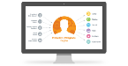


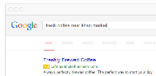









Campaign Management
Campaign Channels
Campaign Types
Owned
Event Driven
Targeted
Website
Email
Payment
Confirmation
Cart
Abandonment
Bundled
Offering
Reminders for
Registered Customers
Personalization
Paid
Shipping
Notification
Search & Display Ads
Seasonal, flash
Sale
Retargeting
SMS
Search based
Earned
Event based
Offerings
Product
Ideation
Every Click makes a
Difference
Social Media
Confidential Property of Tata Industries Ltd – Tata Insights & Quants Division

Slide 39














Email Based Campaigns
Event
Triggered
Messages
Transactional Events
Order Welcome Shipping
Confirmation message Notification
Remarketing Events
Cart New
Abandonment Arrivals
Non Transactional Events
Rewards Birthday Warranty
Earned Notification Expiry
Batch & Blast
Email
Campaign
List Creation
Customer
Segmentation
Email Designing
Opt-out Rates
Confidential Property of Tata Industries Ltd – Tata Insights & Quants Division

Slide 40
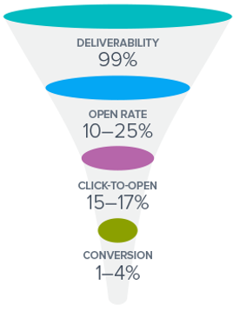
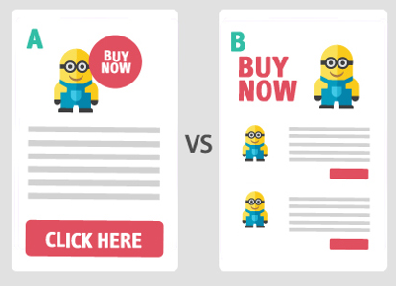
Email Marketing Effectiveness
Conversion Funnel of Email Marketing
A/B testing for Email Sections
Delivery Rate
Opt Out Rate
Click To Deliver Rate (CTDR)
Bounce Rate
Key Metrics
# of clicks / # of emails delivered
# of unsubscribes/ # of emails delivered
(# of emails sent – # of bounce backs) / # of emails sent
# of email campaign visits with a single Page View / # of email campaign
Confidential Property of Tata Industries Ltd – Tata Insights & Quants Division

Slide 41
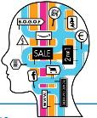











Analytics towards Campaign Relevance
Predict the Likelihood of a
Campaign Response
Mine Customer Data
Impactful & Relevant Campaigns
Basic Demographics
Past
Transactions
Segment 2
Segment 1
Campaign 1
Segment 3
Enriched with Campaign Responses
Segment | Likelihood to Respond
 | Campaign 1 | Campaign 2
One | 20% | 80%
Two | 70% | 25%
Three | 75% | 60%
Campaign 2
Type of Campaign
Open or Click
Revenue Generated
Wallet Size
Confidential Property of Tata Industries Ltd – Tata Insights & Quants Division

Slide 42



Personalization of Email Campaigns
Personalized Email campaign with a message to cross-sell by Spotify
Personalized Recommendation based on user interest by Pinterest
Confidential Property of Tata Industries Ltd – Tata Insights & Quants Division

Slide 43


A Quick Recap
Raison d’etre
Data
Analyze, Act & Measure
Business Problem How to acquire traffic to website at a lower cost |  | What data will I need? Email conversion Display conversion Social conversion Search conversion |  | What Insights can I generate? Email sent to ‘Type B’ customers is most effective ‘Type A’ customers convert most when visit website through a search |  | What Action Can I take? Segment customers and analyze behavior of each segment Create tailor made campaigns for each segment
Confidential Property of Tata Industries Ltd – Tata Insights & Quants Division

Slide 44
01
From Aspiration to Reality
An Integrated Customer View
Confidential Property of Tata Industries Ltd – Tata Insights & Quants Division

Slide 45







Integrated Customer Profile : Digital & Offline
Digital Footprint
Analytics Opportunity
Website Footprint
Online Behavior
Social Footprint
1
Store Recommendation
Demography
Relationship
Share of Wallet
2
Online Product Recommendation
Customer Profile
3
Personalized Offerings/Offer/Campaigns
4
Improve Loyalty Management
Store Locator
Loyalty/Membership
Purchase Frequency
Offline Footprint
Confidential Property of Tata Industries Ltd – Tata Insights & Quants Division

Slide 46





Case Study: Customer Experience Across Channels
UK based Retailer 46 stores £ 4 Billion in Revenue
“The key is recognizing what each device is best for and then tailoring the customer experience to that device.” (Mark Lewis, Online Director)
Offline: Prompt to go Online
Online: Easing customer journey
Offline + Online: Driving Conversion
Signage in Stores to Encourage in-store shoppers to compare and view products on their phones
Customer searches on his App for an out-of-stock item in store
When the Customer is near the store, he gets an alert that the item is now in stock
Confidential Property of Tata Industries Ltd – Tata Insights & Quants Division

Slide 47
10 Retail Brands that Integrate Offline & Online
Wahaca
QR Code on table
Bird’s Eye
Pay by picture
Lloyds Pharmacy
Health Points
In-store kiosks
Amazon Locker
Pikcup from self-service location
Amazon Fresh
Scan items at home
Ikea
Augmented Reality App
Under Armour
Showroom – 80% storytelling
Macy’s
iBeacon’s – Offers on phone when in store
https://econsultancy.com/blog/65064-10-retail-and-ecommerce-stores-integrating-offline-with-online/
Confidential Property of Tata Industries Ltd – Tata Insights & Quants Division

Slide 48
Takeaways
A Few Points to Keep
At the Back of Our Minds
Confidential Property of Tata Industries Ltd – Tata Insights & Quants Division

Slide 49



The Culture we Need
Collaborate
Marketing – Technology – Analytics
Collaborate well in time
Data Mindset
Experimentation
Capture Data
Invest in gathering data, it will be useful tomorrow if not today
Experimentation Culture
Measure, Act, Change
Confidential Property of Tata Industries Ltd – Tata Insights & Quants Division

Slide 50

The Culture we Need
“In God we trust; all others must bring data”
W. Edwards Deming (1900 – 1993)
Developed sampling techniques for US BLS that are used till today
Confidential Property of Tata Industries Ltd – Tata Insights & Quants Division

Slide 51
?
?
Q&A
?
Confidential Property of Tata Industries Ltd – Tata Insights & Quants Division

Slide 52
Thank You

